Slide 1
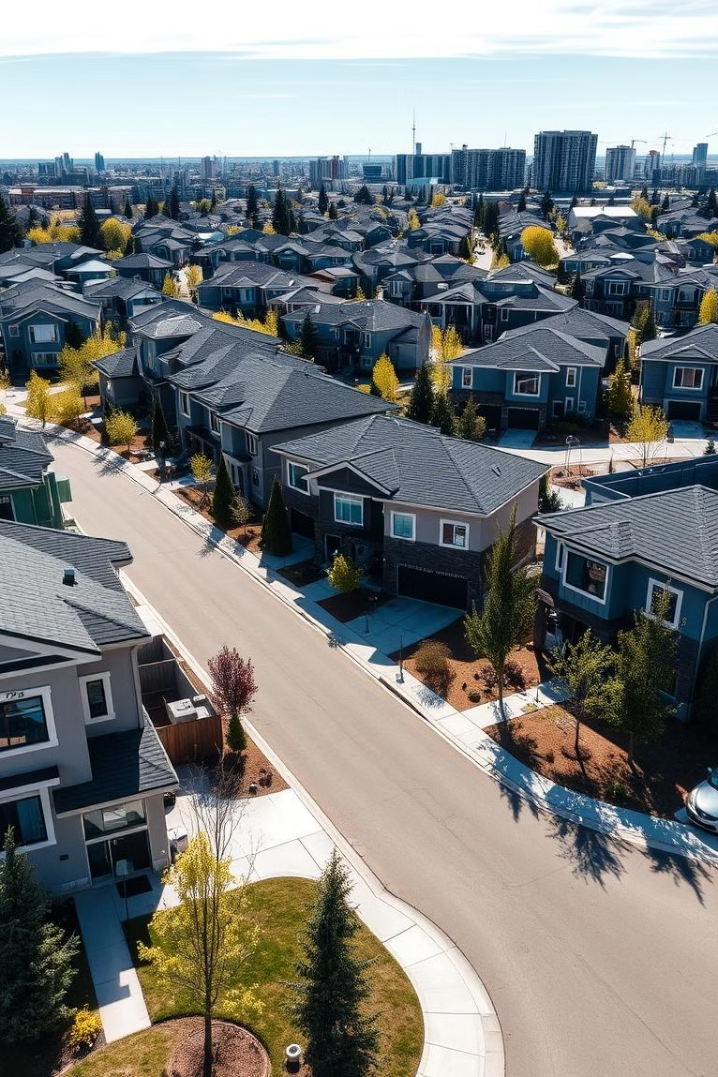

Impact of Property Features on Property Pricing
Glenn Barnes, Lan Dinh, Senkay Li
Data Analytics Capstone
Notes:
Senkay
“Good afternoon everyone. Today, we’ll be presenting our capstone project, which explores the impact of property features on house pricing in Edmonton. First, let me introduce my project group, which including Glenn, Senkay and myself Lan.

Slide 2
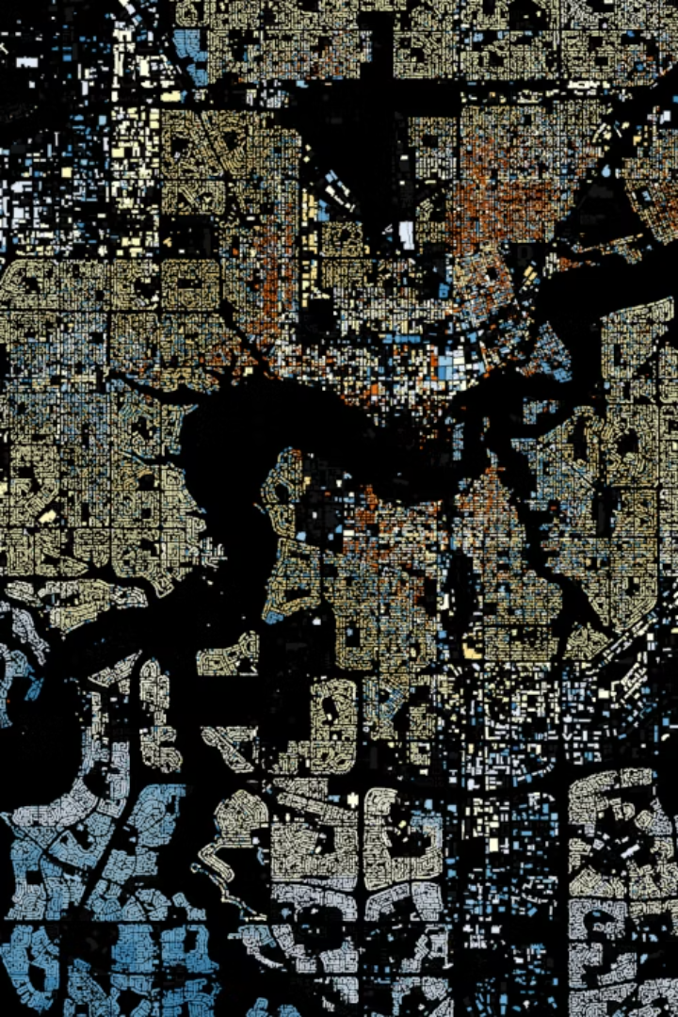
How do property features influence property pricing?
Notes:
Senkay
Our project aims to explore and
Evaluate how property features influence property pricing in Edmonton
based upon neighbourhood, time, and property style segmentation
we sought to uncover trends and patterns that can be valuable for stakeholders. This analysis will help in understanding how these factors interact to influence pricing, ultimately enabling more informed decision-making in the real estate sector. To make the most sense out of the insights gathered from our data, the evaluation of property pricing will be segmented based upon neighborhood regions, time of build year, and property style to hopefully reduce the multicollinearity of the variables

Slide 3
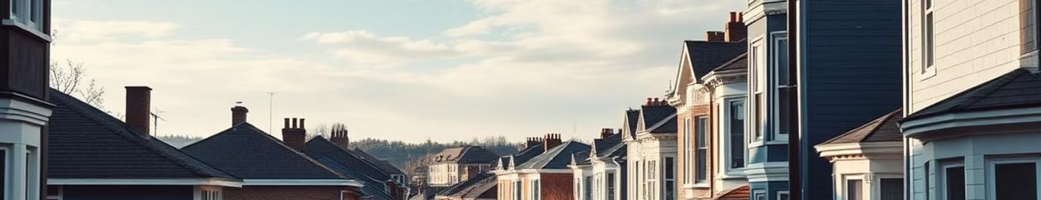
Introduction and Motivation
Background
Motivation
Research Gap
Housing prices depend on physical features like bedrooms, bathrooms, and garages, as well as contextual factors such as neighborhood and crime rates.
Previous studies often overlook how feature impacts vary by local context, property style, and construction year, especially in medium-sized Canadian cities like Edmonton.
There is a lack of segmented, data-driven analyses that jointly consider crime, construction periods, and architectural typology in Edmonton's housing market.
Notes:
Lan
Let’s begin with why we chose this topic. While it’s well-known that features like bedrooms and bathrooms influence house prices, many studies overlook how these effects vary by local context—especially in cities like Edmonton. In particular, the role of neighborhood crime rates is often underexamined, even though it can significantly influence buyer behavior and perceived property value. Our motivation was to fill this research gap by analyzing how pricing dynamics shift across neighborhoods, time periods, and architectural styles.

Slide 4

Research Objectives and Questions
1
Quantify Feature Effects
2
Segmented Pricing Analysis
Measure how bedrooms, bathrooms, basement, garage, and crime influence sale price.
Examine pricing differences across neighborhoods, year-built intervals, and property styles.
3
Stakeholder Insights
4
Key Questions
Support buyers and agents with data-driven decision-making and pricing strategies.
Identify which features add most value and how trends vary by location and time.
Notes:
Lan
“Our 4 objectives are:
Measure how features like bedrooms, bathrooms, basements, garages, and local crime influence prices.
Segment our analysis by neighborhood, year-built, and property style.
Provide useful insights to buyers, agents, and investors.
Identify which features add the most value, and how trends vary by location and time.​

Slide 5
Benefits and Real-World Relevance
For Buyers
For Agents
For Investors
Understand which features add value to make informed purchase decisions and avoid overpaying.
Leverage evidence-based pricing to optimize marketing, negotiations, and client returns.
Identify trends to optimize acquisitions and portfolio management for long-term gains.
Notes:
Lan
“Our work has practical benefits for multiple stakeholders:
For buyers, it can help make informed decisions and avoid overpaying.​
For Agents, can use these insights to optimize marketing, negotiations, and client returns.
For investors, can better target their acquisitions for long-term gains. Ultimately, our analysis supports more informed, evidence-based decision making.”

Slide 6
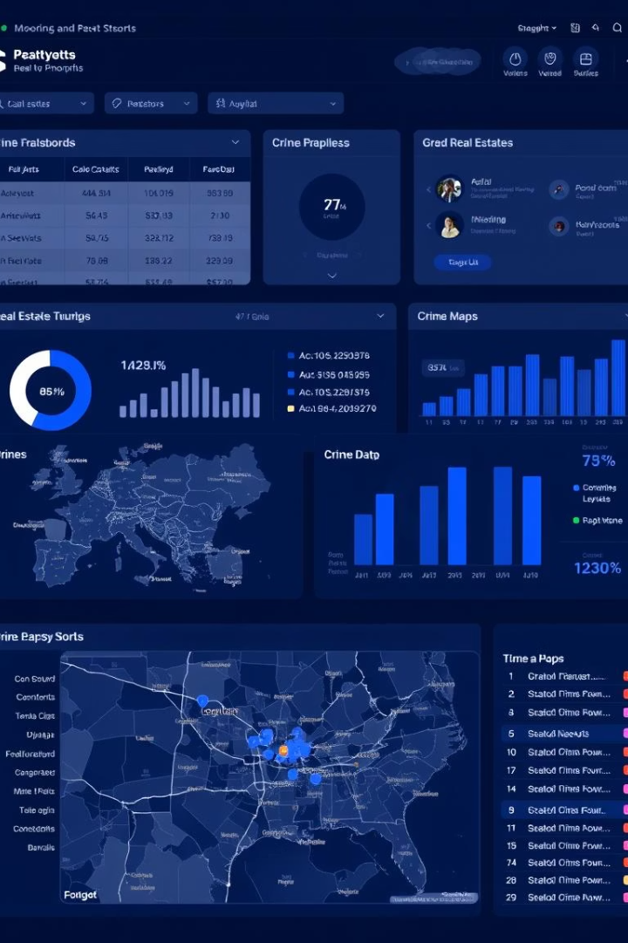
Data Description
Property Sales Data
Over 300,000 residential transactions in Edmonton from 2000-2024 with detailed features like bedrooms, bathrooms, basement, garage, and year built.
Neighborhood Crime Data
Aggregated crime incidents by neighborhood, including theft, burglary, and vehicle offenses, normalized for analysis.
Neighborhood Metadata
Geographic and planning information for Edmonton neighborhoods, enabling spatial analysis of pricing patterns.
Notes:
Lan
“We used a rich dataset of over 300,000 residential transactions in Edmonton from 2000-2024, paired with crime data by neighborhood and detailed geographic information. This enabled us to perform both feature-level and spatial analyses of the housing market.”

Slide 7
Methodology: Data Preparation
Data Cleaning
Data Integration
Standardized column names, removed irrelevant variables, and handled missing values to ensure data quality.
Merged property sales, crime, and neighborhood datasets using neighborhood identifiers, resulting in 319,494 unified records.
Notes:
Lan
“Our first step was cleaning and standardizing the data. We removed irrelevant or incomplete entries, and merged property sales with crime and neighborhood metadata. The result was a high-quality dataset with over 319,000 unified records.”

Slide 8
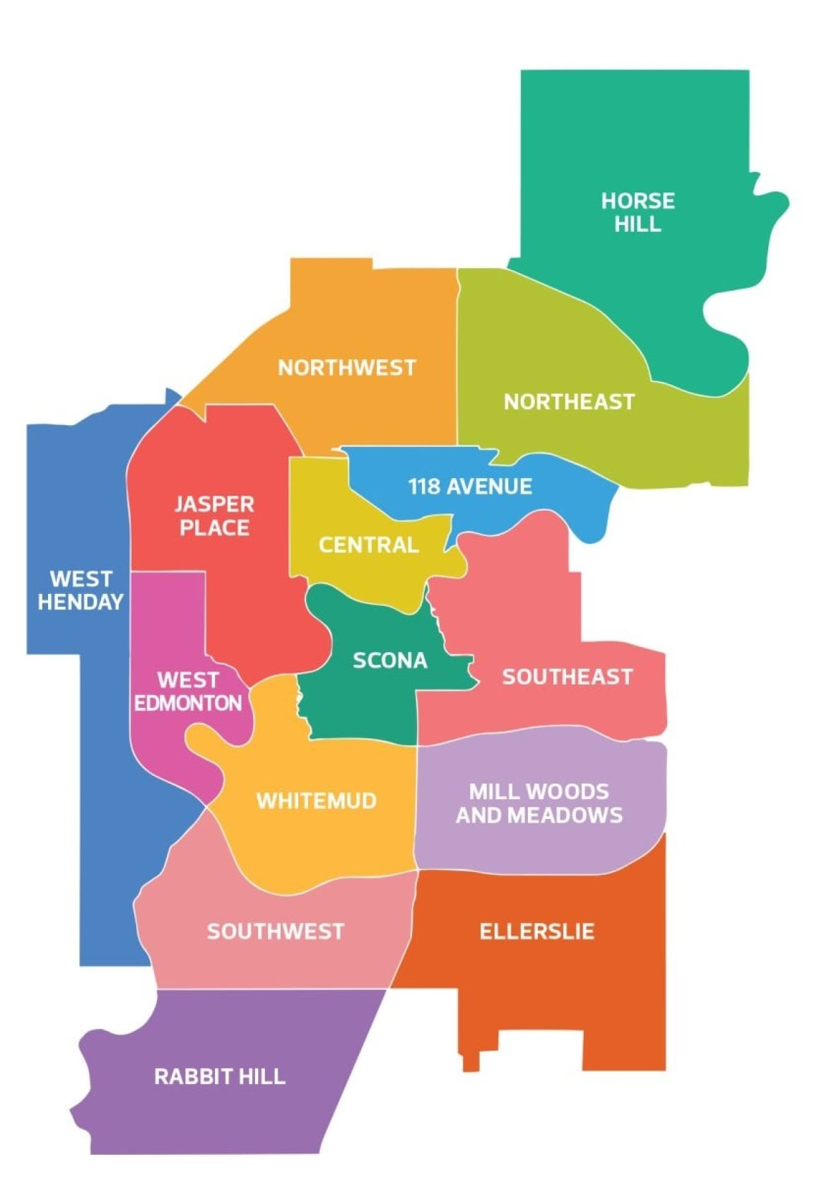
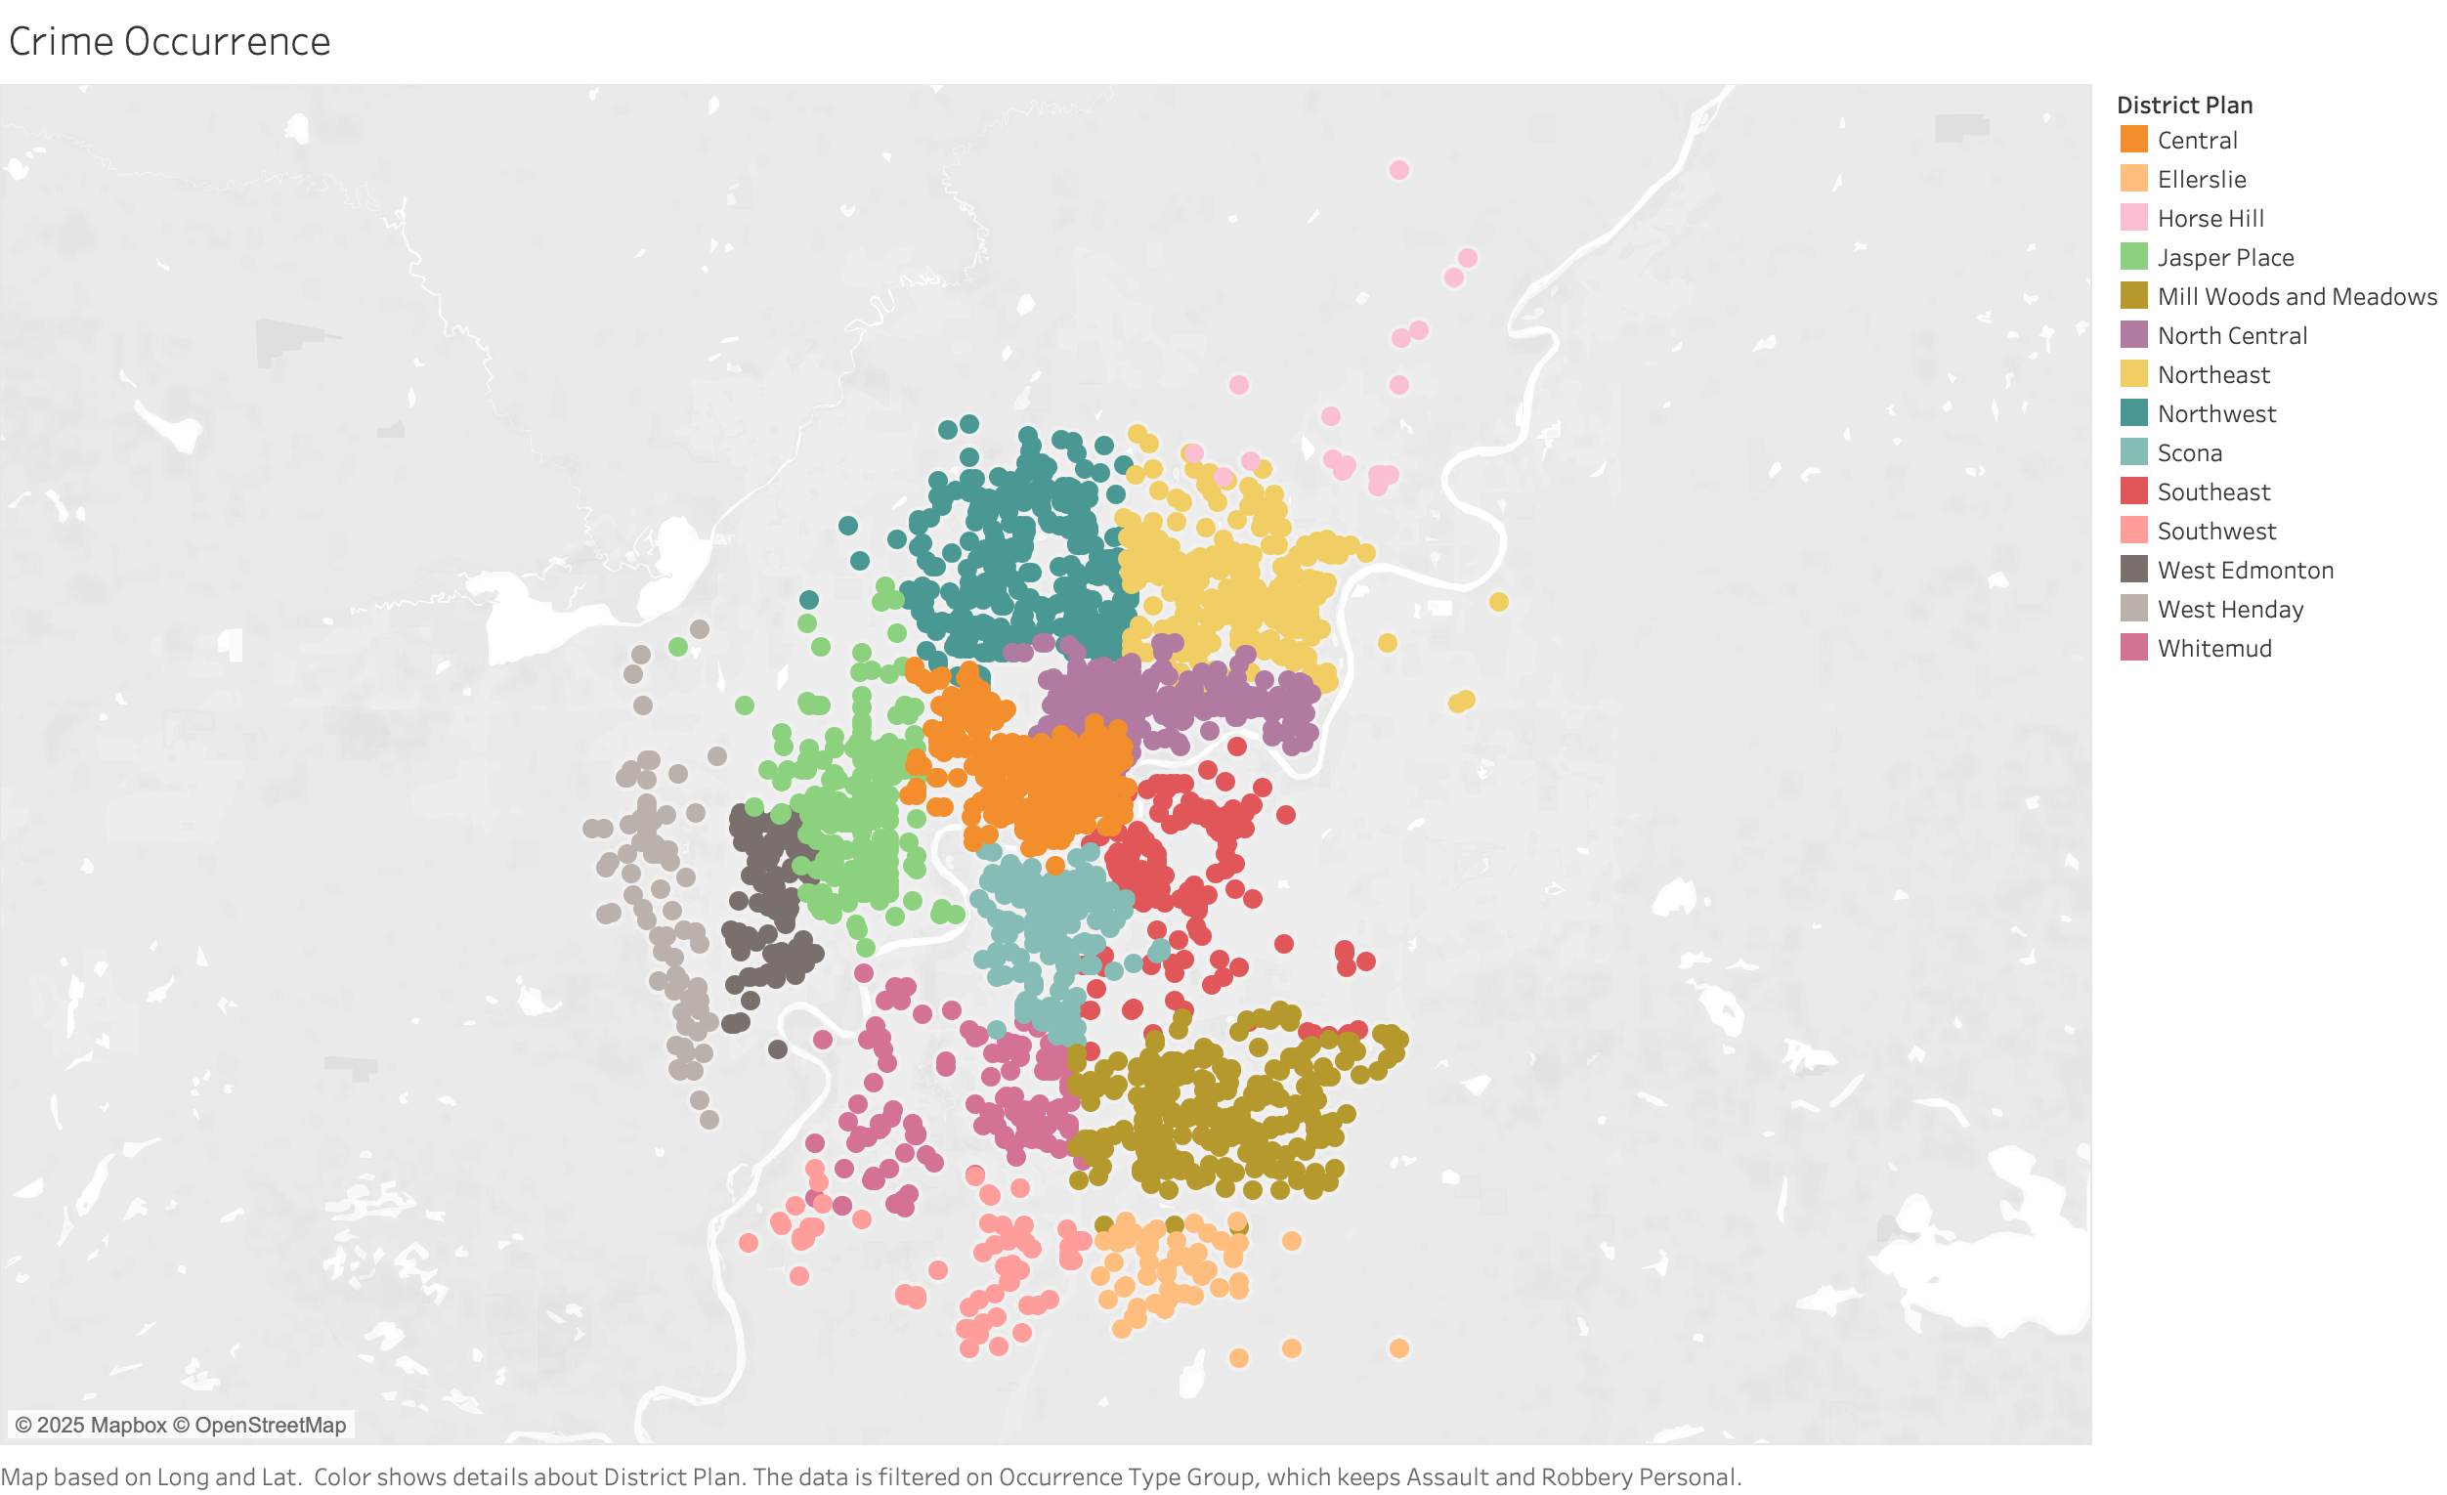
Findings: Literature and Exploratory Data Analysis
Notes:
Senkay
crime density was figured out by manually using google maps to determine the area of the district
in conjunction with literature, we performed EDA to examine the features influence on the sale price
first lets look at crime density across the various districts in Edmonton

Slide 9
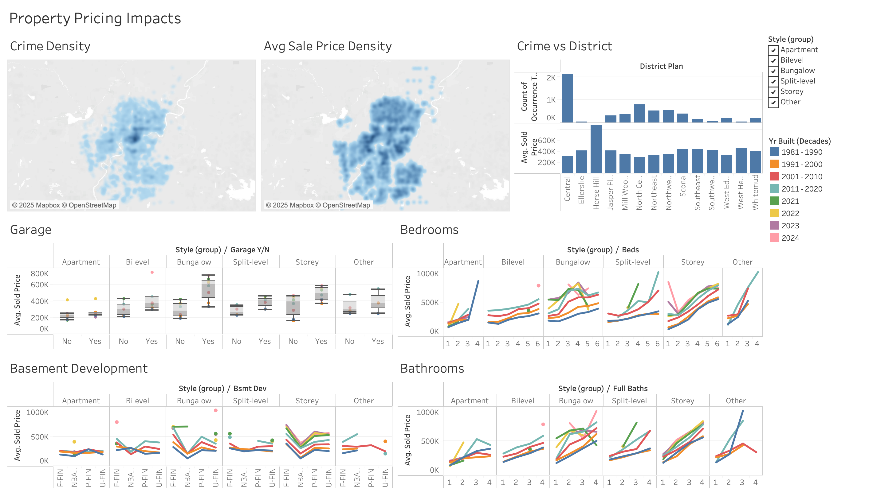
Notes:
Senkay
crime was more focused on the central district
when compared to sold price, the general trend is that higher crime density has lower sales price, and the opposite is also true
more informative than crime rate (crime per population)
Garage higher pricing
finished basements generally higher
the dip in the graph is seen for properties with no basements
general trend of more beds higher price
generally higher baths also higher price
based off these findings, it informed us on which features to focus more on for the modelling
I’ll now invite Glenn to talk about these

Slide 10

Methodology: Feature Engineering and Modeling
1
Feature Engineering
2
Modeling
Created variables like property age, bathroom-bedroom ratios, crime rate per capita, and seasonal categories.
Applied Linear Regression, Random Forest, and XGBoost models, evaluated by RMSE and R² scores.
3
Data Splitting
Used 80% training and 20% testing splits to validate model performance.
Notes:
This research aimed to predict residential property sale prices in Edmonton, Alberta, utilizing advanced machine learning methods and comprehensive predictive features. The methodological framework employed encompasses a rigorous multi-step approach, including data acquisition, preprocessing, integration, feature engineering, and predictive modeling.
To manage data volume and ensure computational efficiency, crime data were aggregated at the neighborhood level. These aggregated crime statistics were then merged with property sales and neighborhood metadata datasets based on neighbourdood_name, resulting in a unified dataset containing 319,494 records.
Feature Engineering
The analysis further involved the creation of additional derived variables aimed at enhancing predictive capability:
Property age (property_age)
total_baths, full_baths
Crime rate per capita
Sale seasons and construction year categories
Categorical variables were transformed using one-hot encoding to facilitate their integration into predictive models.
Feature Selection and Preprocessing
A variance threshold of 0.01 was applied to remove low-variance features, reducing dimensionality while preserving predictive relevance.
Numerical features underwent imputation and scaling, whereas categorical features were consistently encoded through structured pipelines using scikit-learn.
The dataset was partitioned into training (80%; 255,595 records) and testing sets (20%; 63,899 records) to rigorously evaluate predictive models.

Slide 11
Findings: Individual Dataset Analysis
Property Attributes
Location Dynamics
Size, age, bathroom/bedroom counts drive values
Geographic context substantially enhances predictions
Crime Impact
Integrated Analysis
Negative correlation with prices, moderate effect
Combined datasets improved accuracy by revealing key price drivers
Notes:
Findings
Individual Dataset Analysis
Property Sales Data: Structural attributes like property size, age, bathroom, and bedroom counts significantly impacted property valuations.
Crime Data: Neighborhood crime negatively correlated with property prices, though its effect was moderate.
Neighborhood Metadata: Geographic context substantially enriched the predictive insights, emphasizing the importance of location and spatial dynamics in determining market prices.
Integrating all datasets significantly enhanced predictive accuracy. Key influencing features included listing price per square foot, bathroom counts, bedrooms, property dimensions, age, architectural style, property classification, and neighborhood crime levels.

Slide 12
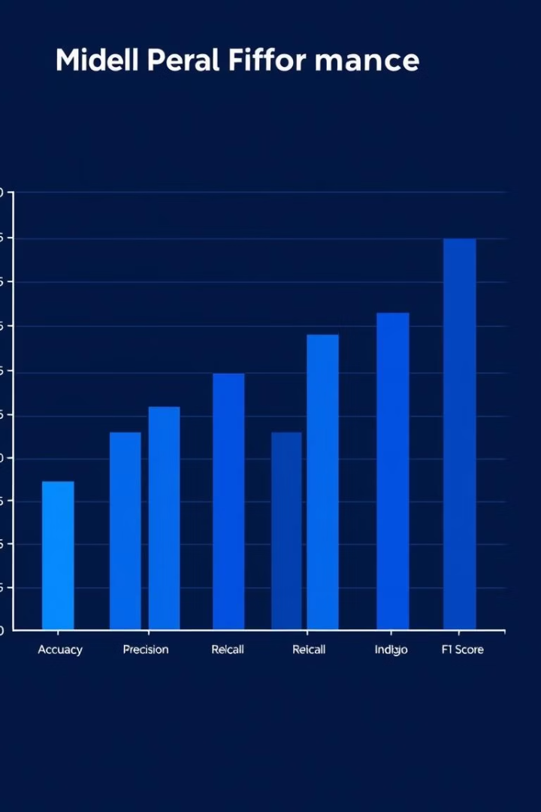
Modeling, Evaluation and Performance
Model
RMSE (CAD)
R² Score
Linear Regression
$76,340
0.79
Random Forest
$48,265
0.92
XGBoost
$48,522
0.92
Random Forest achieved the best accuracy and interpretability, effectively modeling complex relationships in property pricing.
Notes:
Modeling and Evaluation
Three regression models were applied and comparatively evaluated:
Linear Regression (baseline)
Random Forest Regressor
XGBoost Regressor
Models were assessed based on Root Mean Squared Error (RMSE) and the coefficient of determination (R²), providing clear indicators of predictive accuracy and explanatory power.
Model Performance Summary
Model / RMSE (CAD) / R² Score
Random Forest emerged as the best-performing model, characterized by the lowest RMSE and high R², effectively capturing complex non-linear relationships within the data.

Slide 13

Exploring Advanced Models
Randomized Search CV
Neural Networks
Final Model Choice
Feedforward neural networks trained with TensorFlow struggled to outperform Random Forest due to data characteristics.
Random Forest was selected for its high accuracy, robustness, and interpretability.
Hyperparameter tuning of Random Forest did not significantly improve R² beyond baseline.
Notes:
To further improve the model's performance, we experimented with:
Randomized Cross-Validation (RandomizedSearchCV):
Hyperparameter tuning was applied to the Random Forest model.
Despite extensive tuning, the R² score did not improve significantly beyond the baseline Random Forest model.
Neural Networks:
A feedforward neural network was implemented using TensorFlow/Keras.
The model was trained with various architectures (e.g., hidden layers, activation functions) and hyperparameters (e.g., learning rate, batch size).
However, the neural network struggled to outperform the Random Forest model, likely due to the tabular nature of the dataset and the relatively small size of the training data for deep learning.
Final Model Selection
Given the results, we chose to proceed with the Random Forest Model due to its:
High accuracy (R² = 0.92)
Robustness to overfitting
Interpretability (e.g., feature importance analysis)

Slide 14
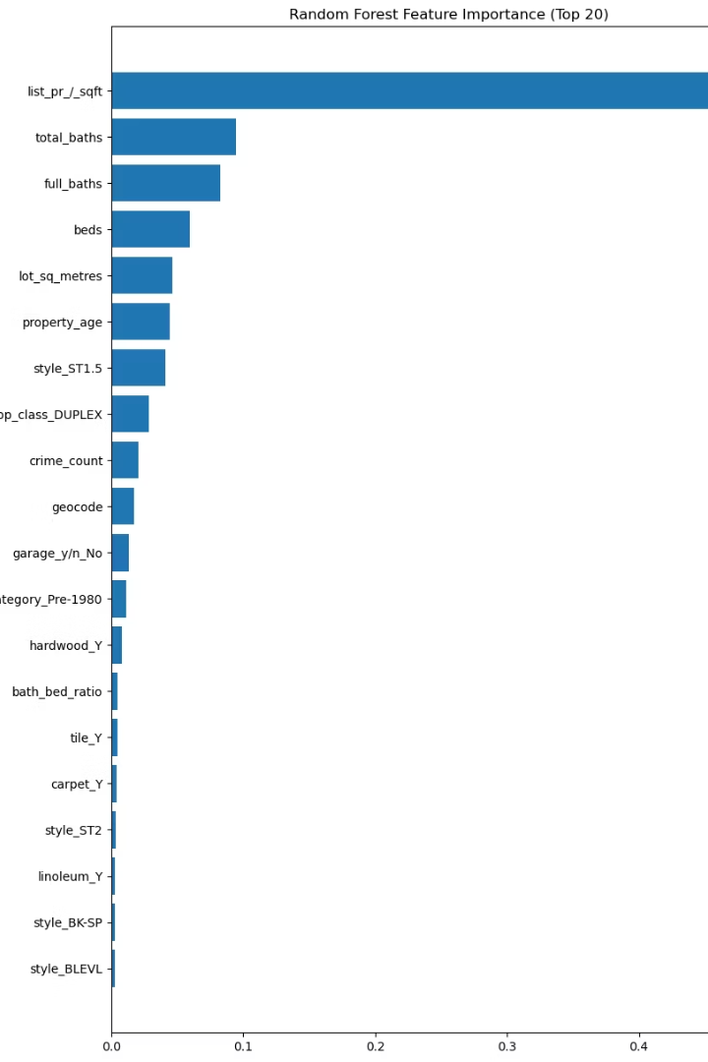
Feature Importance and SHAP Analysis
Random Forest Insights
Listing price per square foot, bathroom counts, bedrooms, lot size, property age, and two-storey style strongly influence prices.
Notes:
The analysis leveraged feature importance metrics derived from two robust predictive models, Random Forest and XGBoost, augmented by SHAP (SHapley Additive exPlanations) values to interpret the predictive relationships and feature contributions within the housing market in Edmonton, Alberta. These visualizations not only quantify the relative importance of features but also illustrate their directionality and interactions, thus enhancing interpretability for stakeholders.
The Random Forest feature importance plot identified the most influential property attributes impacting price predictions. As depicted in Figure the dominant feature emerged as the listing price per square foot (list_pr_/_sqft), significantly outperforming other predictors. This attribute's prominence underscores its role as a critical pricing benchmark within local market transactions. Other substantial features included the number of full and total bathrooms, number of bedrooms, and lot size (lot_sq_metres),reinforcing the importance of structural dimensions and facilities in market valuations. Moreover, age (property_age) and property styles (notably two-storey homes,style_ST2) significantly influenced property prices, reflecting market preferences forarchitectural attributes.

Slide 15
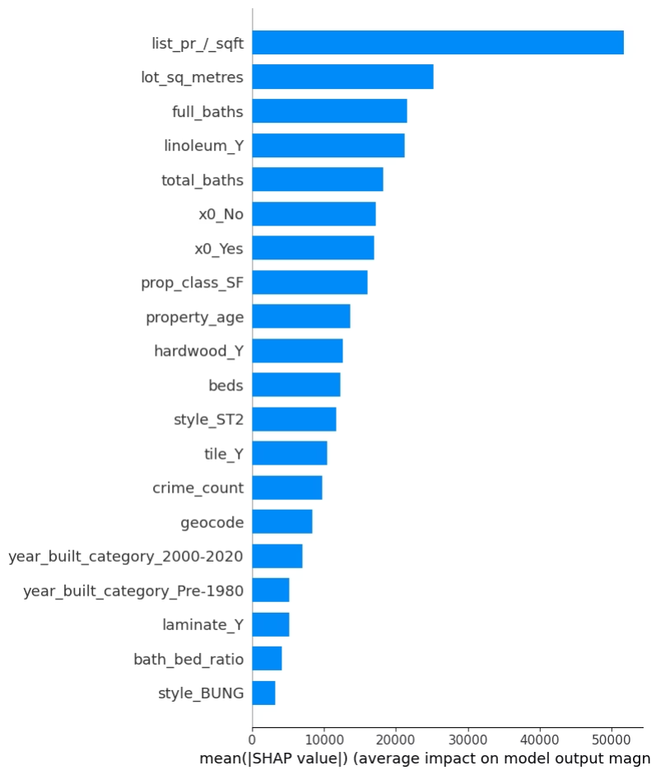
SHAP Summary
Higher price per square foot and more bathrooms positively impact predicted prices, showing complex feature interactions.
Notes:
SHAP summary plots provided deeper insights into the distribution and directional impact of feature values on individual predictions. Confirming the findings from Random Forest importance rankings, list_pr_/_sqft exhibited substantial influence, with higher values consistently correlating positively with increased property prices. The SHAP values indicate both linear and non-linear relationships, clearly illustrating the complexity inherent within property valuation. Furthermore, features such as lot size and bathroom count displayed discernible patterns, reinforcing their fundamental impact on valuation predictions.

Slide 16
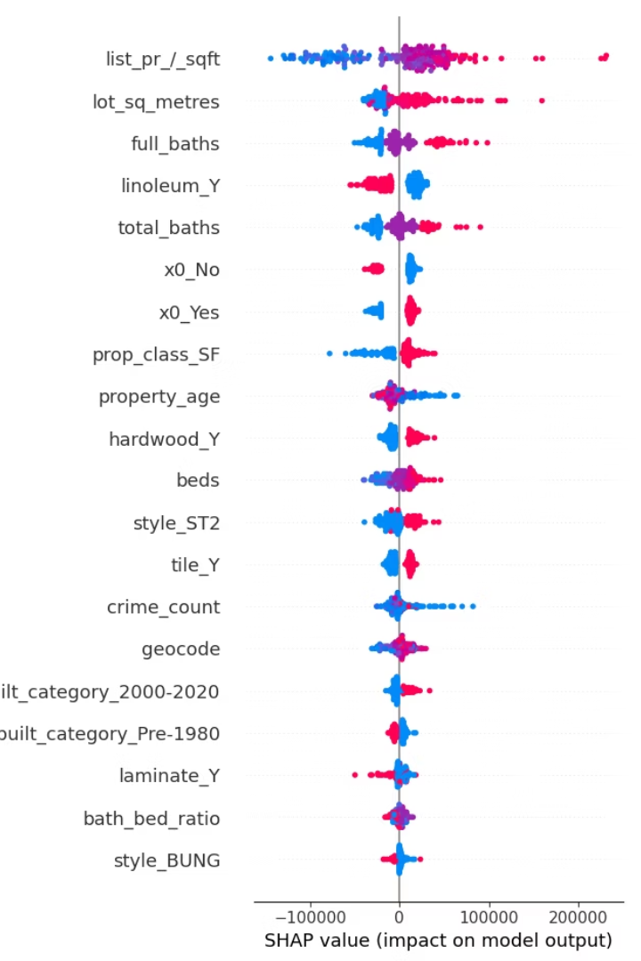
Additional Visualizations and Model Comparisons
Mean Absolute SHAP Values
Confirms key features: price per square foot, lot size, and bathrooms dominate impact on pricing.
XGBoost Differences
Elevates architectural style and garage presence in importance, highlighting model-specific sensitivities.
Notes:
The mean absolute SHAP value chart (Figure 4) aggregates the overall magnitude of feature impacts, highlighting the predominance of certain variables across the model. Consistent with prior plots, the highest mean impacts were attributed to list_pr_/_sqft, followed by lot_sq_metres and full_baths.
Overall, this combined feature importance and SHAP value assessment provided comprehensive insights into the key determinants of property pricing in Edmonton.

Slide 17

Discussion: Research Questions and Insights
Model Performance
Key Predictors
Crime Impact
Non-linear models outperform linear regression, capturing complex valuation factors.
Listing price per square foot, bathroom count, and property age consistently predict prices.
Crime negatively affects prices moderately, suggesting other quality-of-life factors weigh more.
Notes:
The analysis affirmed that non-linear models significantly outperform linear regression, underscoring the complexity inherent in real estate valuation. Key attributes like listing price per square foot, bathroom quantity, and property age emerged as consistent predictors. Crime negatively influenced prices but with less intensity than anticipated, suggesting a nuanced role within local market dynamics.

Slide 18
Surprising Discoveries and Limitations
Surprising Findings
Limitations
Garages and architectural styles have notable influence; crime impact less than expected
Crime data aggregated at neighborhood level, data for only one year
Sold data may not be comprehensive
Notes:
Senkay
The analysis revealed unexpected insights, such as the considerable influence of garages
and specific architectural styles on home valuations. Additionally, the moderate impact of
crime suggested buyers may prioritize other quality-of-life factors more heavily.
crime is neighbourhood agg, other factors like socio-economic and temporal (schools, transit) variables are not considered
crime is only 1 year (this may not be an accurate representation)
sold data may not encompass all impactful features, renovations
other features such as condition and quality are also missing
other external factors such as school districts, transit, walkability
seasonality, buyer vs sellers market and other trends are also not accounted for
"While these limitations don't invalidate the insights, they highlight areas for future improvement and caution in interpreting the results. Incorporating more granular and diverse data — or using more complex modeling — could help address some of these gaps.” also lend to some further research or studies

Slide 19

Recommendations for Future Research
Detailed proximity to amenities, school ratings, and demographic data
Advanced models: LightGBM, CatBoost, and ensemble methods
Explicit temporal analyses, could improve precision and market insights
Such enhancements will deepen understanding of real estate dynamics and support more accurate forecasting and valuation in Edmonton.
Notes:
Senkay
Future analyses could benefit from incorporating additional granular data such as
proximity to amenities, school ratings, and detailed demographic and economic indicators.
Further exploration of advanced modeling techniques (LightGBM, CatBoost, ensemble
stacking methods) and explicit temporal analyses could significantly enhance model
precision and market insight.

Slide 20
Further Inquiries
Contact Us
Email: aboutus@LGS.com
Phone: 780.123.3960
Website: www.LGS.com
Notes:
Senkay
Thank you for your attention today, feel free to let us know your comments and any questions you may have

